Slide 1
Duniversity College Portal
BY
Harshini Inturi
Sai Manoj
Trainer:Murali Mohan
V17 DevOps

Slide 2
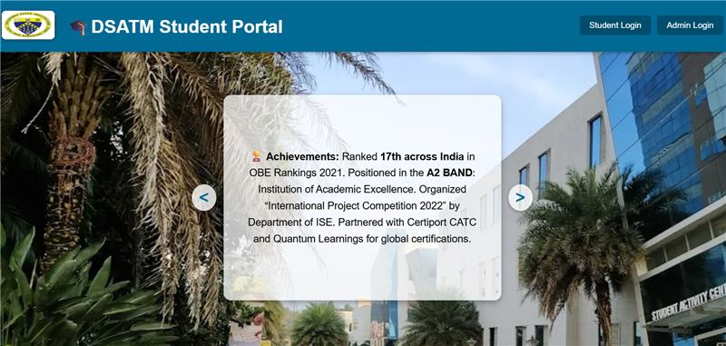
PROBLEM STATEMENT
Duniversity currently operates with disconnected systems and manual processes, leading to inefficiencies and poor user experience.
There is a need for a unified portal that integrates core college functions such as registration, attendance, grades, Semester Time Tables.

Slide 3
PROJECT GOALS
To create a centralized college portal for managing academic and administrative tasks.
To streamline operations like student registration, timetable management, attendance tracking, and internal communication.
To replace manual and fragmented systems with an integrated digital solution

Slide 4
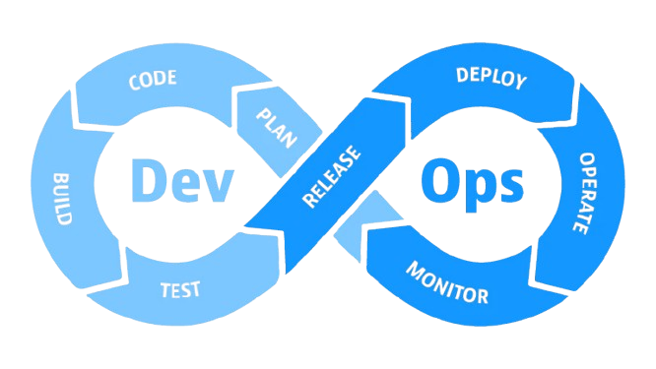
DEVOPS
Version Control : Git +GitHub for code collaboration​
​
CI/CD : Jenkins Pipeline and Automated deployment using EKS.​
​
Containerization : Docker, Docker-compose​

Slide 5
TECHNOLOGY,TOOLS AND COMPONENTS
Application Layer: Node.js Express.js HTML,CSS, JavaScript EJS​
Database Layer: MySQL
Containerization: Docker, Docker Compose, Docker Hub ​
Container Orchestration (Production):Kubernetes (K8s), Deployments, config via YAML
CI/CD Pipeline: Jenkins​
Cloud / Infrastructure: AWS,EC2​ and Terraform
Monitoring and observability tool: Grafana, Prometheus

Slide 6
DATA FLOW IMPLEMENTATION
Developer → pushes code to GitHub​
Jenkins CI/CD → builds Docker image using Dockerfile​
Image Pushed → to AWS ECR / DockerHub
Jenkins-7 stages creating pipeline using AWS credentials, Docker credentials and Kubernetes​
Kubernetes (EKS) → pulls image & runs container​
MySQL Pod/Service → , ​stores the values of attendance, time table
Prometheus → collects metrics (CPU, memory, pods, requests/sec)​
Grafana → visualizes metrics & builds dashboards​
​

Slide 7
JENKINSFILE
Jenkins file: Script that defines the CI/CD pipeline.​
Written in Groovy syntax.​​
Steps included in this:
Pull source code from GitHub​
Build Docker image​
Push image to DockerHub/ECR​
Deploy to Kubernetes cluster
Pipeline
Automated workflow for CI/CD (Continuous Integration & Continuous Deploy
Includes stages like Build → Test → Deploy.​ Kubernetes​
Container: It is an orchestration platform to deploy and manage containers at scale.​ Ensures high availability, scaling, and self-healing.​

Slide 8
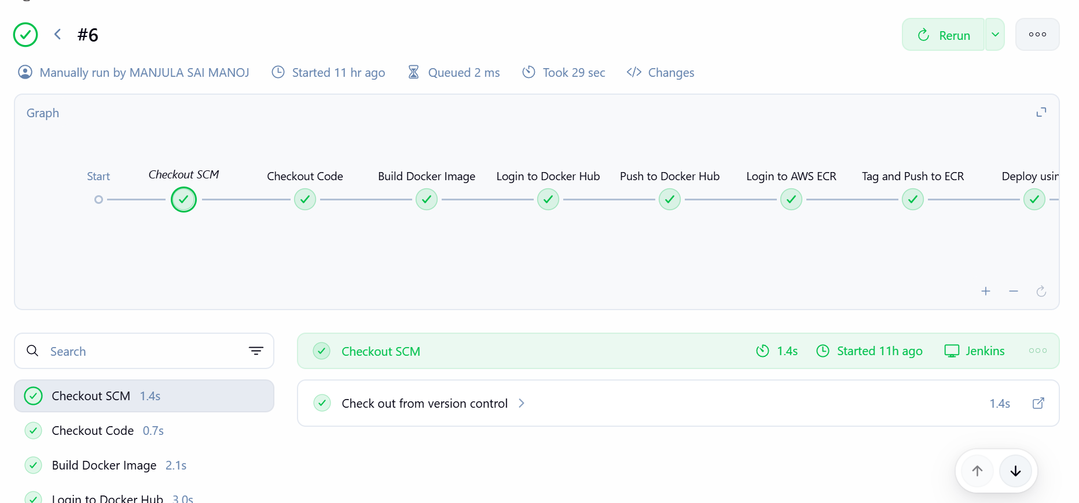
PIPELINE

Slide 9
TERRAFORM
Terraform is an open-source Infrastructure as Code (IaC) tool developed by HashiCorp. It allows you to define and provision infrastructure using a declarative configuration language.
Why do we use terraform?
Automated Infrastructure Management: You can create, update, and delete cloud resources (like servers, databases, networks) automatically.
Multi-Cloud Support: Works with AWS, Azure, Google Cloud, and many other providers.
Version Control: Infrastructure configurations can be stored in Git, enabling collaboration and rollback.
Reusable Modules: You can define reusable components for consistent deployments.
IaC tool: It is used to create VPC,EC2 instance, subnets, route tables and cluster. It is also a cloud agnostic tool where multiple providers can run it.

Slide 10
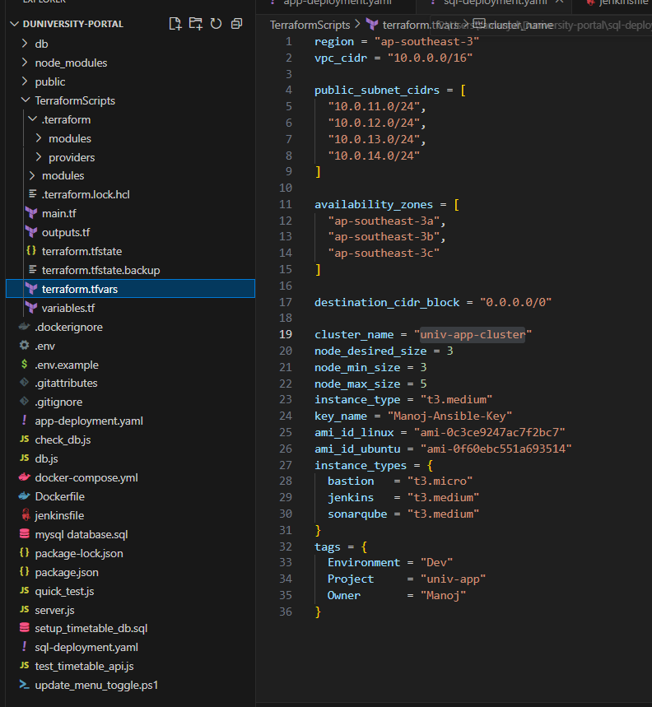

Slide 11
DOCKER
Docker is a platform that allows developers to package applications and their dependencies into containers. These containers are lightweight, portable, and ensure that the application runs consistently across different environments.
Why do we use Dockerfile and Docker Image?
Dockerfile: A text file that contains a set of instructions to build a Docker image. It defines the base image, environment setup, dependencies, and commands to run the application.
Docker Image: A snapshot of the application and its environment, created from the Dockerfile. It can be shared and deployed anywhere Docker is supported.

Slide 12
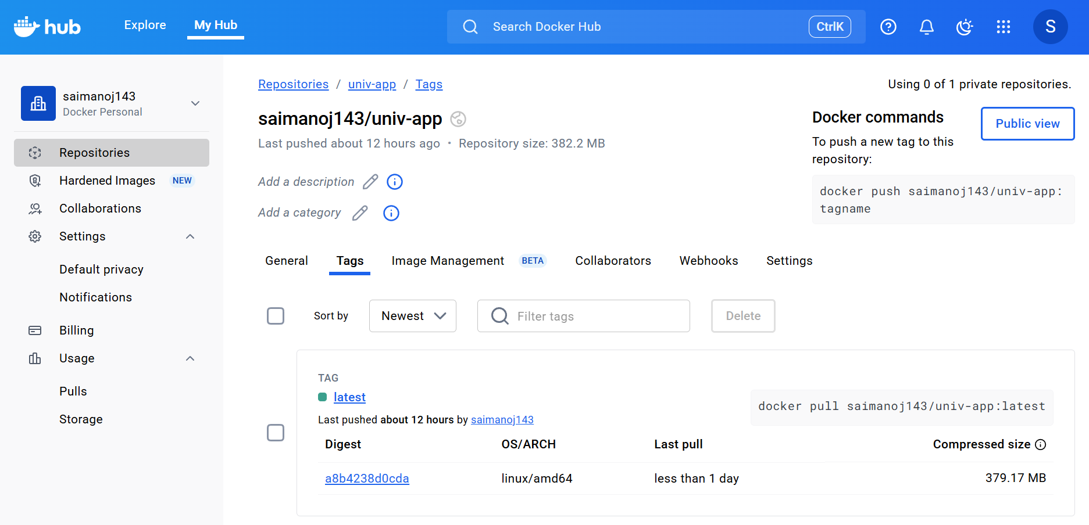

Slide 13
KUBERNETES
Kubernetes (often abbreviated as K8s) is an
open-source container orchestration platform
that automates the deployment, scaling, and
management of containerized applications.
Why do we use Kubernetes?
Automated Deployment & Scaling: It handles rolling updates, load balancing, and scaling based on demand.
Self-Healing: Automatically restarts failed containers and replaces unhealthy nodes.
Service Discovery & Load Balancing: Routes traffic to the right containers efficiently.
Multi-Cloud & Hybrid Support: Works across public clouds, private clouds, and on-premises environments.

Slide 14
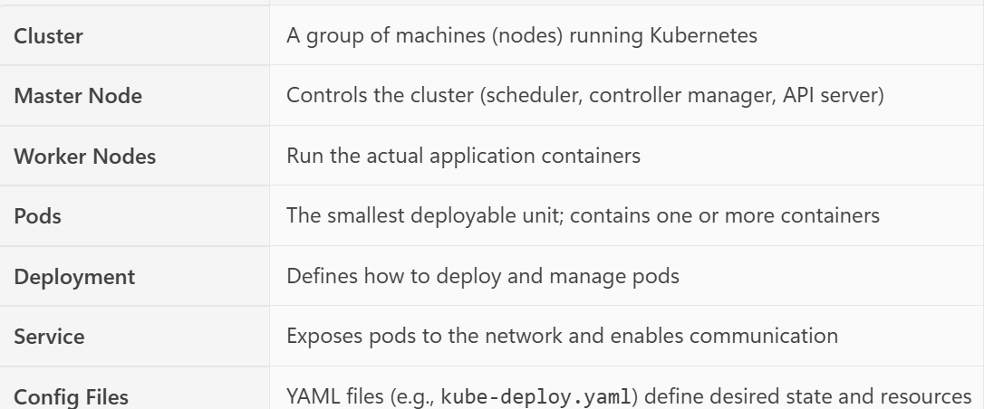
IMPLEMENTATION OF KUBERENTES

Slide 15
GRAFANA
Grafana is an open-source data visualization and monitoring tool. It allows users to create interactive and customizable dashboards to monitor metrics from various data sources like Prometheus, InfluxDB, MySQL, and more.
Monitoring with Grafana:
Data Collection: Tools like Prometheus collect metrics from servers, containers, or applications.
Data Source Integration: Grafana connects to these tools as data sources.
Dashboard Creation: Users create panels and dashboards to visualize metrics.
Alert Configuration: Alerts are set based on conditions (e.g., CPU > 80%) and sent via email,etc.
Continuous Monitoring: Dashboards update in real-time, helping teams detect and respond to issues quickly.

Slide 16
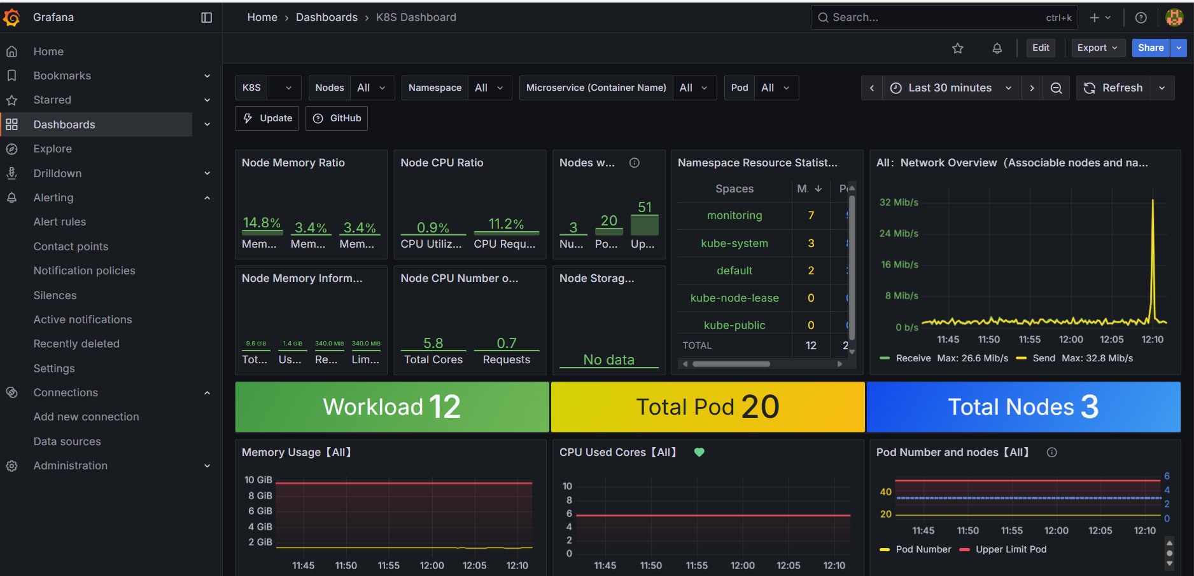

Slide 17
PROMETHEUS
Prometheus is an open-source monitoring and alerting toolkit designed for reliability and scalability. It collects metrics from configured targets at specified intervals, stores them efficiently, and allows for alerting.
Why do we use Prometheus?
Time-Series Data Collection: Prometheus stores metrics as time-series data, making it ideal for performance monitoring.
Powerful Query Language (PromQL): Enables flexible and detailed analysis of metrics.
Alerting Integration: Works with Alert manager to send alerts based on defined rules.
Cloud-Native & Kubernetes Friendly: Designed to work seamlessly with containerized environments.

Slide 18
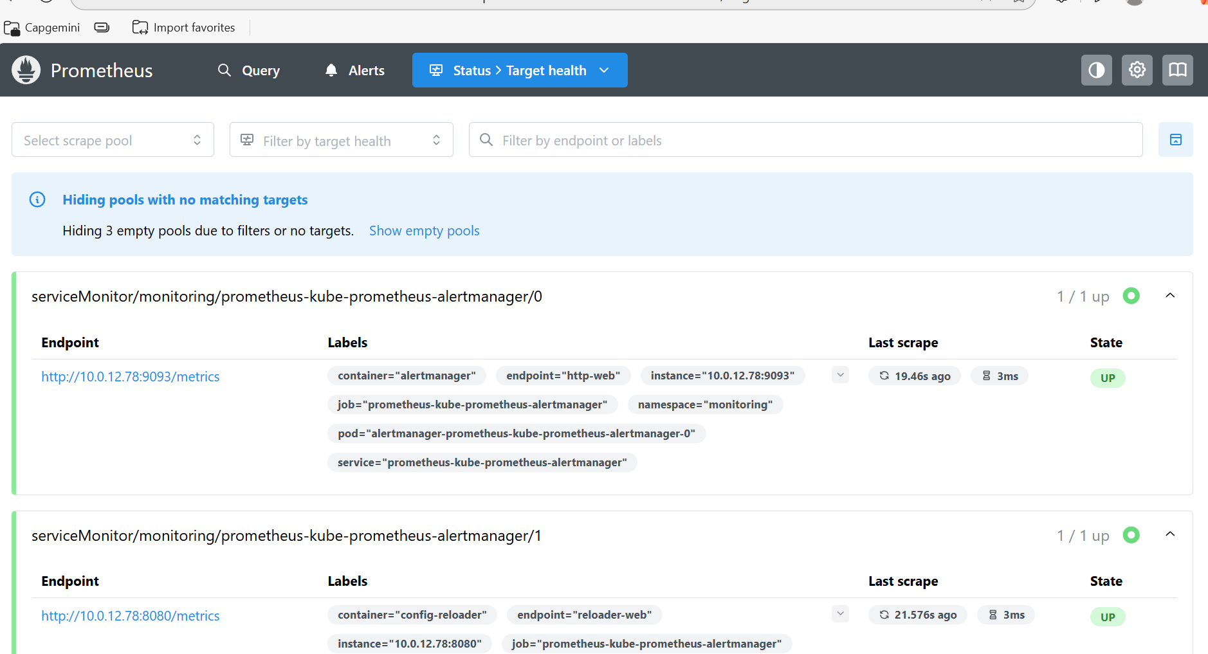

Slide 19
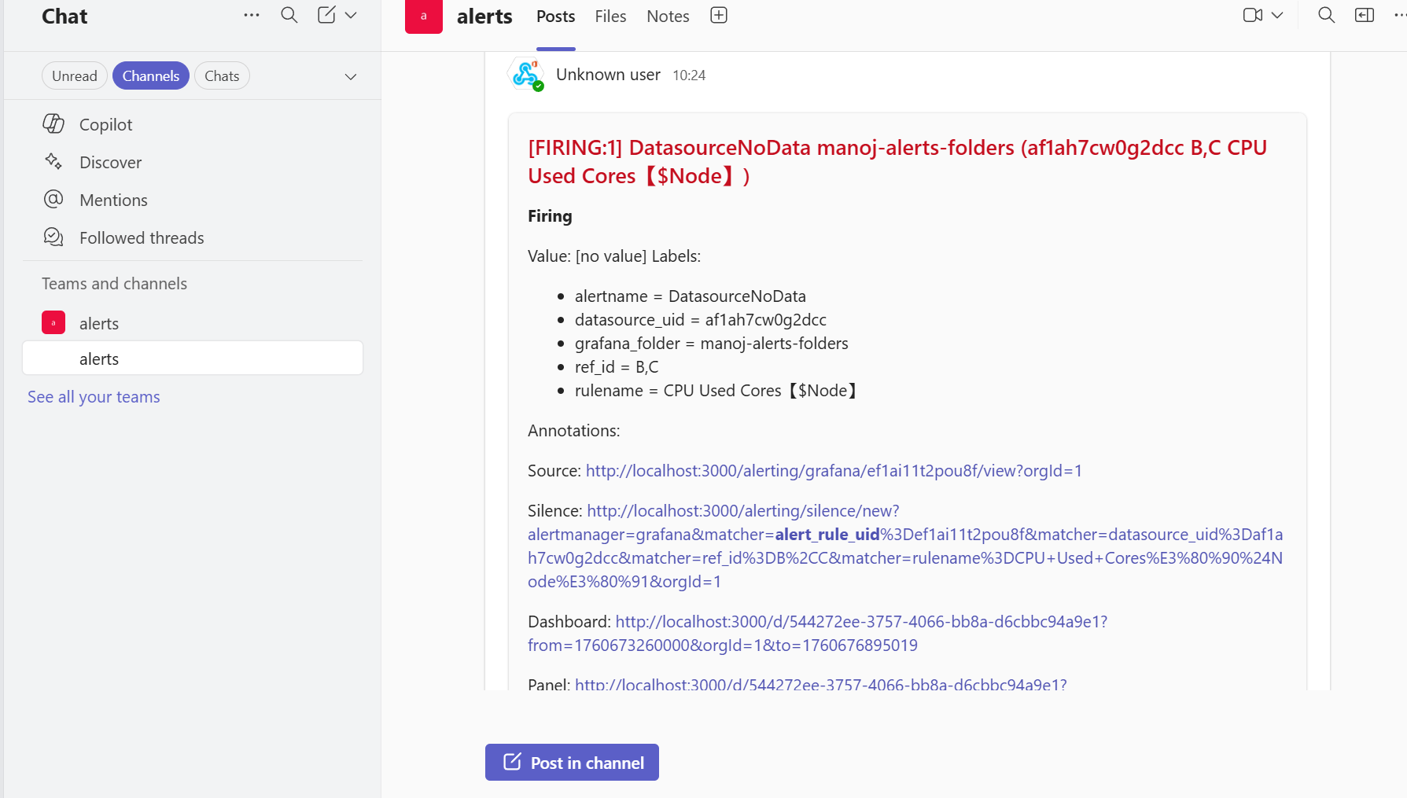
TRIGGERING THE ALERTS USING GRAFANA

Slide 20
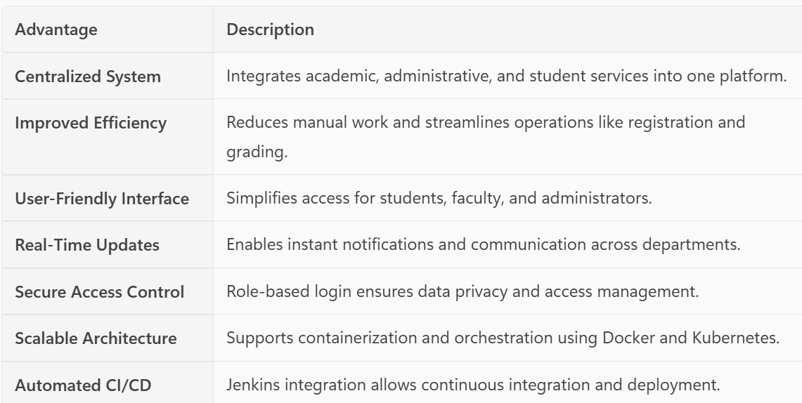
Advantages and Applications

Slide 21
CONCLUSION
The Duniversity College Portal provides a unified digital platform that streamlines academic and administrative operations for students, faculty, and administrators.
It enhances efficiency, transparency, and user experience through automation, secure access, and integrated services.
The portal promotes digital transformation in education by replacing manual processes with automated, cloud-integrated solutions, ensuring scalability and long-term sustainability

Slide 22
THANK YOU

